Slide 1

COURSE OVERVIEW

Slide 2

INTRODUCTION
Rehan Haider
A decade of experience as Solution Architect, over 15 years in technology
Designed solutions for over 200 clients
Built and sold first startup at 16
Tutored Mathematics, C & Python Programming while still in College
AWS Certified Solutions Architect - Professional
Bachelor of Technology in Computer Science & Engineering
I am ..
Zen
Android Evangelist
Tech & Security Blogger
Tinkerer
Amateur Cricket Player

Slide 3
COURSE OBJECTIVES
Learn about AWS Platform, Global Infrastructure, and Products
Hands-on expertise with AWS compute, storage, and database using AWS Management Console
Hands-on experience with AWS deployment and management services
Hands-on experience with networking and security features of AWS
Learn to configure and operate various AWS Products
Knowledge of recommended best practices for building secure and reliable applications on AWS platform
Learn how to build an fault-tolerant, scalable, and highly resilient applications on AWS from grounds up

Slide 4
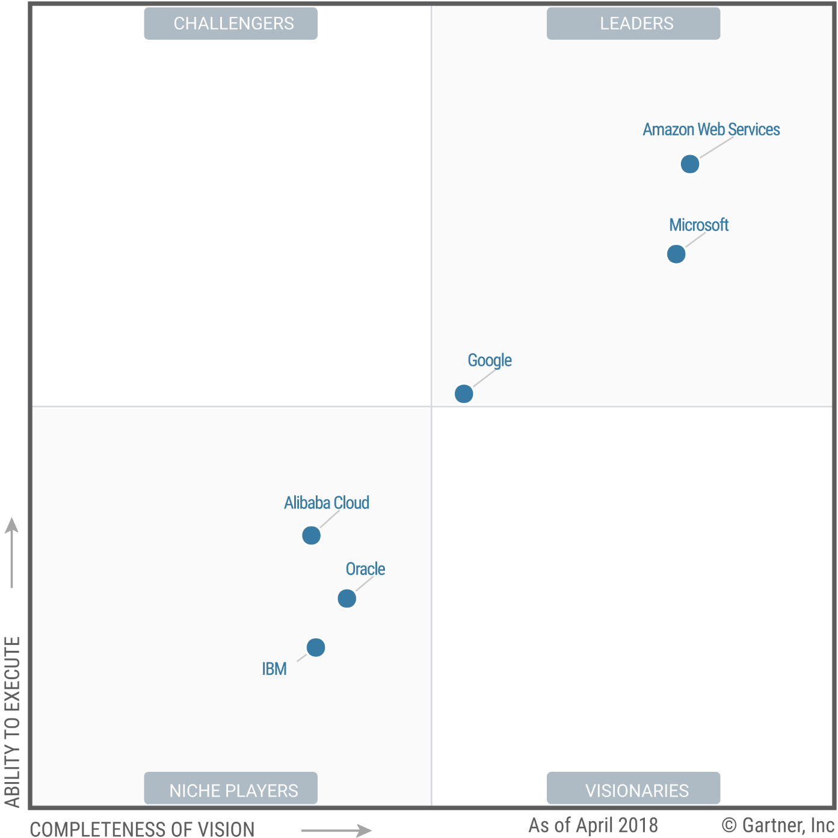
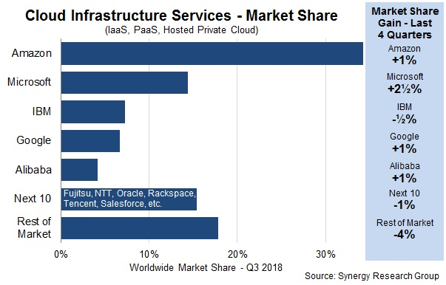
WHY AWS?
Gartner Magic Quadrant for IaaS puts AWS as the undisputed leader
AWS is the Market Leader
Gartner study suggest AWS is the market leader in both the vision and the ability to execute
AWS rapid innovation rate is proof
AWS is bigger than the next 4 biggest competitors combined.
AWS has a market share of 40%, which is still growing
AWS’ innovation is the highest with over 1000 new offering unveiled in 2018
AWS is not just market leader, but does bleeding edge innovations, e.g. the Satellite as a Service is a unique unparalleled offering.

Slide 5
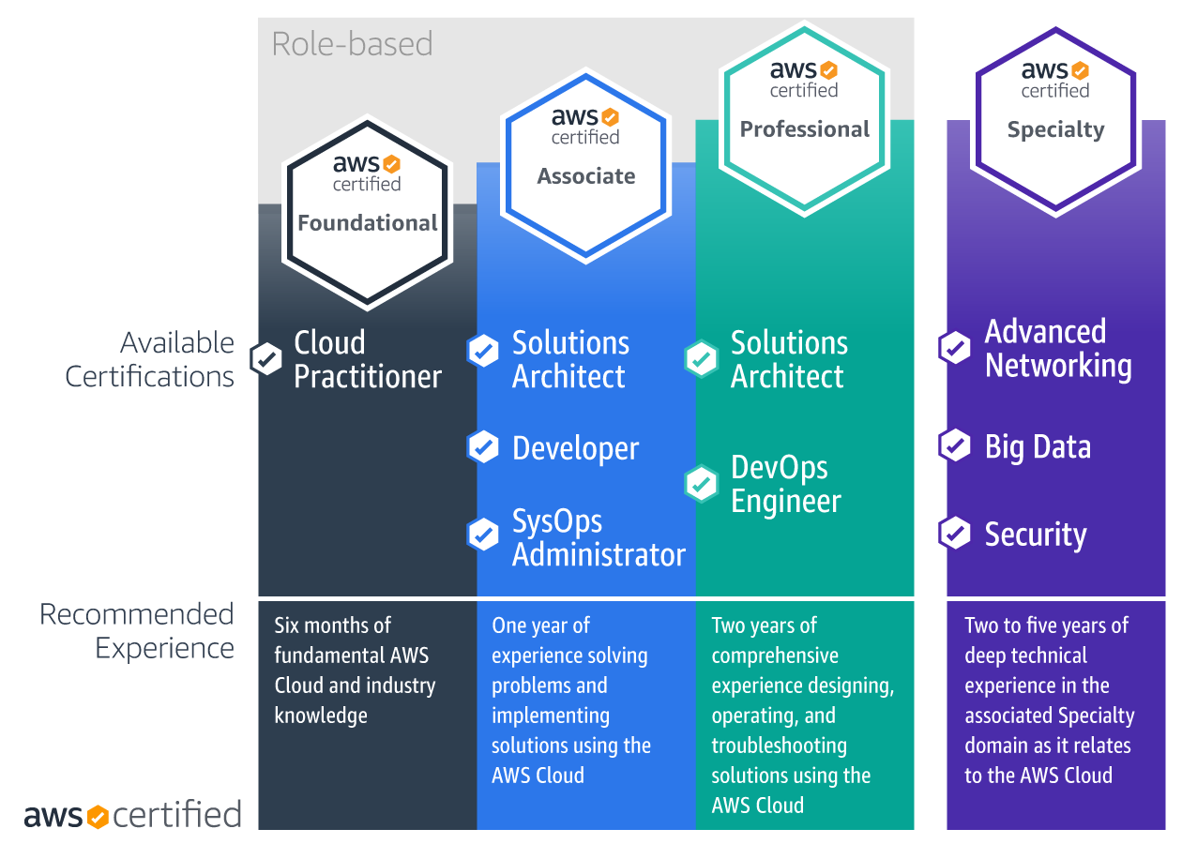
AWS CERTIFICATIONS
Market Value
Least
Most
Role-Based Certifications
AWS offers role-based certifications to validate expertise for those in
Cloud Practitioner,
Architect,
Developer,
and Operations roles, plus Specialty certifications
to validate advanced skills in specific technical areas.
AWS Solutions Architect - Associate
Validates your ability
Demonstrate knowledge of how to architect and
deploy secure and robust applications on AWS technologies.

Slide 6




PREREQUISITES
A Computer
Either Windows, Linux, or MAC will do
Either Terminal or Putty/PowerShell to login to the systems
AWS Free Tier Account – Register at https://aws.amazon.com/free/
Willingness to learn helps
AWS Account
AWS Free Tier Account – Register at https://aws.amazon.com/free/
You will need a credit card to register
A Command Line Interface
For Windows PCs: Either Putty or PowerShell (with SSH installed)
For Mac or Linux: Terminal utility
Notes:
Link to guide to configure SSH on PowerShell
https://www.howtogeek.com/336775/how-to-enable-and-use-windows-10s-built-in-ssh-commands/

Slide 7
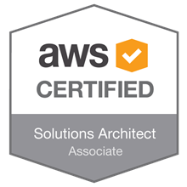
EXAM BLUEPRINT
AWS Certified Solutions Architect – Associate Exam
130 minutes in duration
60 questions – all MCQ
Some Qs may have more than one correct answer
Total Marks 1,000, Passing Marks – 720
Requires ~72% to pass the exam
Scenario Based Questions
Content outline
Domain | % of Examination
Design Resilient Architectures | 34%
Define Performant Architecture | 24%
Specify Secure Applications and Architectures | 26%
Design Cost-Optimised Architectures | 10%
Defined Operationally Excellent Architectures | 6%
Total | 100%
Download it here - https://aws.amazon.com/certification/certified-solutions-architect-associate/

